Slide 1


APPLICATION FOR EDUCATING STUDNTS ON INTELLECTUAL PROPERTY RIGHTS
Matrusri Engineering College
(An Autonomous Institution)
(Sponsored by: MATRUSRI EDUCATION SOCIETY, Estd: 1980)
(Approved by AICTE, Affiliated to Osmania University)
# 16-1-486, Saidabad, Hyderabad-500059, Ph: 040-24072764
By -
Ayush Pallod
Under Guidance of -
Mrs. K. Bhagyalaxmi
Asst. Professor

Slide 2

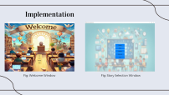
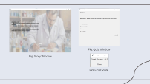
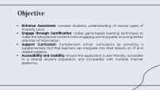

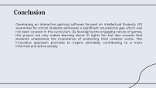
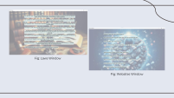
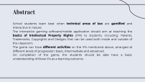

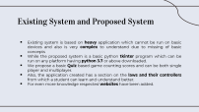


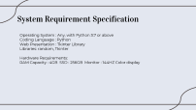
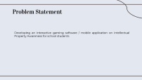
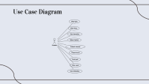


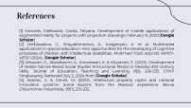

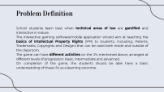
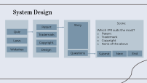
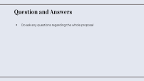

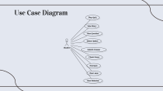
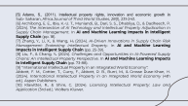
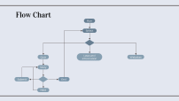
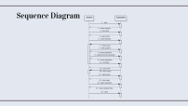
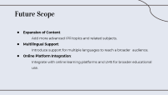


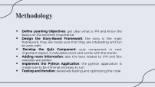



Contents

Slide 3
Abstract
School students learn best when technical areas of law are gamified and interactive in nature.
The interactive gaming software/mobile application should aim at teaching the basics of Intellectual Property Rights (IPR) to students, including: Patents, Trademarks, Copyrights and Designs that can be used both inside and outside of the classroom.
The game can have different activities on the IPs mentioned above, arranged at different levels of progression: basic, intermediate and advanced.
On completion of the game, the students should be able have a basic understanding of these IPs as a learning outcome .

Slide 4
Objective
Enhance Awareness: Increase students understanding of various types of Property Laws.
Engage through Gamification: Utilize game-based learning techniques to make the educational content more engaging and enjoyable, ensuring better retention of information.
Support Curriculum: Complement school curriculums by providing a supplementary tool that teachers can integrate into their lessons on IP and related subjects.
Accessibility and Usability: Ensure the application is user-friendly, accessible to a diverse student population, and compatible with multiple internet platforms.

Slide 5
Problem Statement
Developing an interactive gaming software / mobile application on Intellectual Property Awareness for school students

Slide 6
System Requirement Specification
Operating System : Any, with Python 3.7 or above
Coding Language : Python
Web Presentation : Tkinter Library
Libraries: random, Tkinter
Hardware Requirements:
RAM Capacity : 4GB SSD : 256GB Monitor : 144HZ Color display

Slide 7
Existing System and Proposed System
Existing system is based on heavy application which cannot be run on basic devices and also is very complex to understand due to missing of basic concepts
While the proposed system is a basic python tkinter program which can be run on any platform having python 3.7 or above downloaded.
We propose a basic Quiz based game counting scores and can be both single player and multiplayer.
Also, the application created has a section on the laws and their controllers from which a student can learn and understand better.
For even more knowledge respected websites have been added.

Slide 8
System Design
Score:
Which IPR suits the most?
Patent
Trademark
Copyright
None of the above
Story
Patent
Quiz
Trademark
Laws
Copyright
Websites
Design
Questions
Submit
Next
End

Slide 9
Flow Chart
Run
Select
Quiz
Laws and information
Websites
Story
Submit
End
Next

Slide 10
Problem Definition
School students learn best when technical areas of law are gamified and interactive in nature.
The interactive gaming software/mobile application should aim at teaching the basics of Intellectual Property Rights (IPR) to students, including: Patents, Trademarks, Copyrights and Designs that can be used both inside and outside of the classroom.
The game can have different activities on the IPs mentioned above, arranged at different levels of progression: basic, intermediate and advanced.
On completion of the game, the students should be able have a basic understanding of these IPs as a learning outcome .

Slide 11
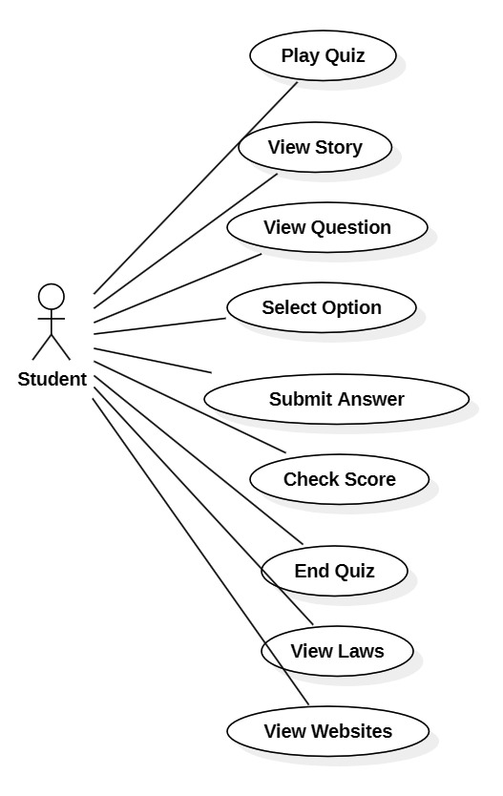
Use Case Diagram

Slide 12
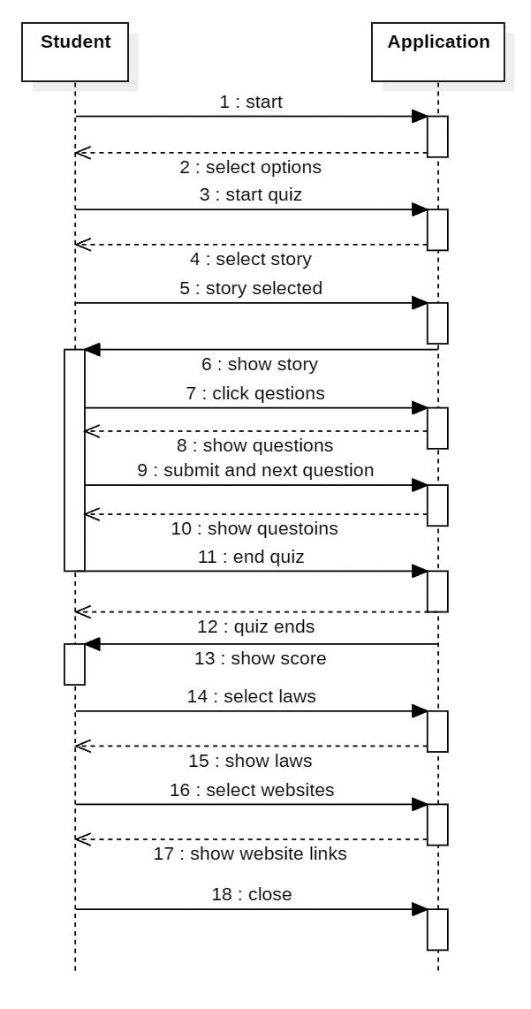
Sequence Diagram

Slide 13
Methodology
Define Learning Objectives: get clear what is IPR and know the basics of IPR and their importance.
Design the Story-Based Framework: the story is the main framework, they are made sure that they are interesting and fun to work with.
Develop the Quiz Component: quiz component in next important aspect, it calculates score and works with the stories
Adding more information: also the laws related to IPR and few websites are added
Implement the Python Application: the python application is made sure to be minimal and easy to run
Testing and Iteration: iteratively testing and optimizing the code

Slide 14
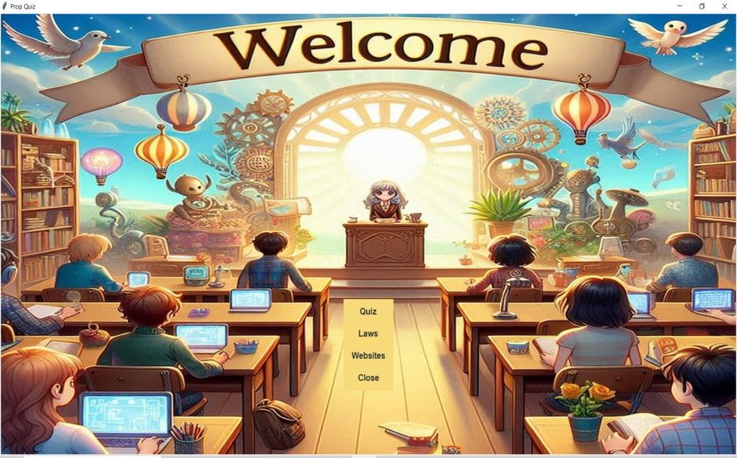
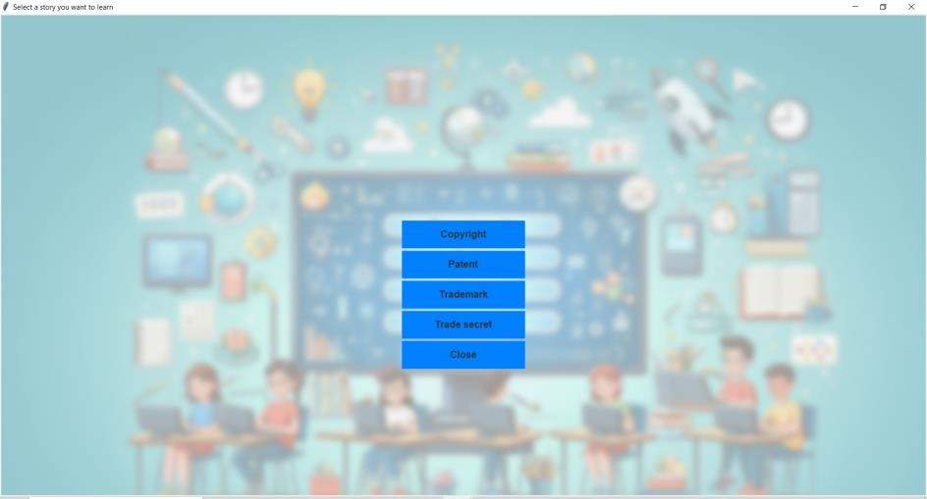
Implementation
Fig: Welcome Window
Fig: Story Selection Window

Slide 15
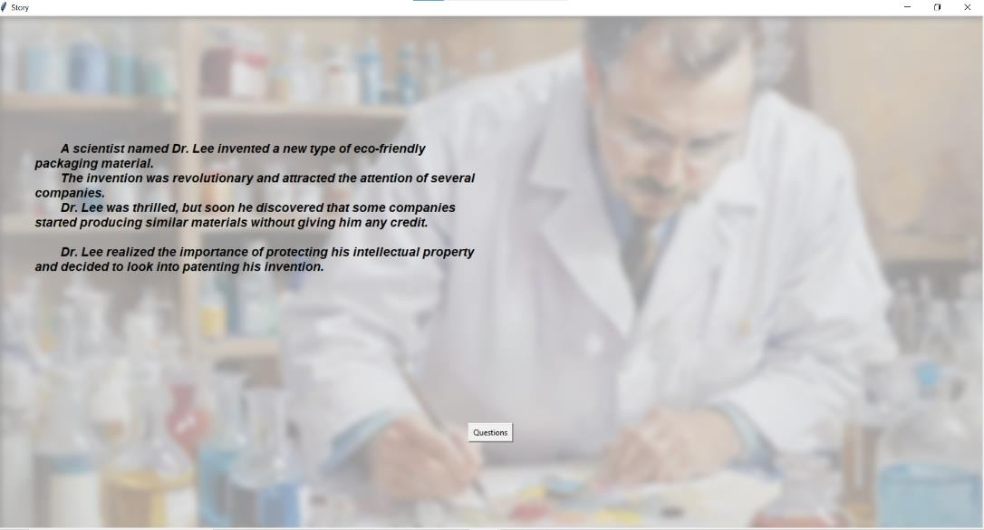
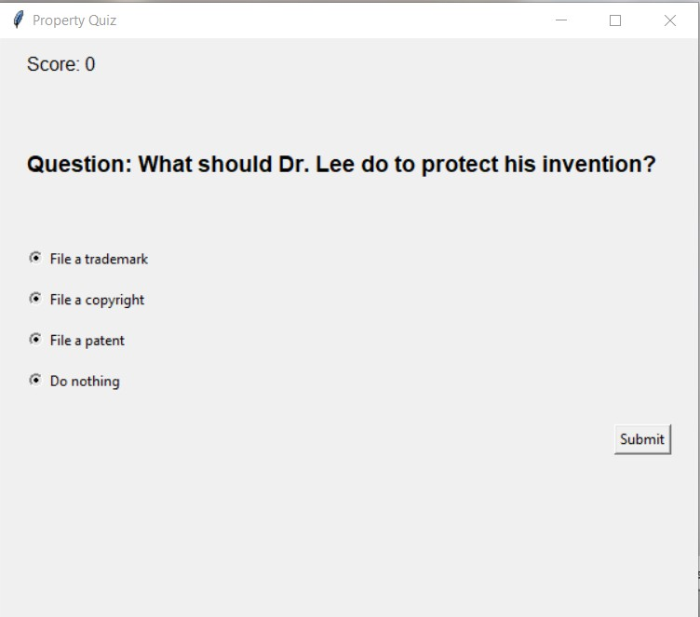
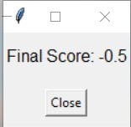
Fig: Quiz Window
Fig: Story Window
Fig: Final Score

Slide 16
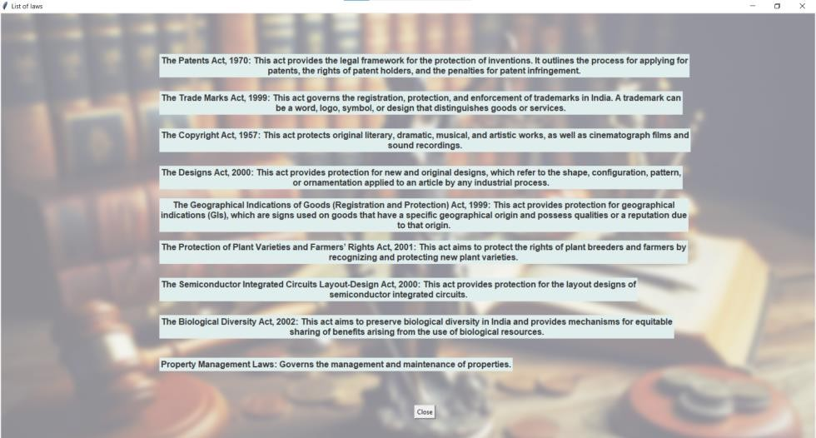
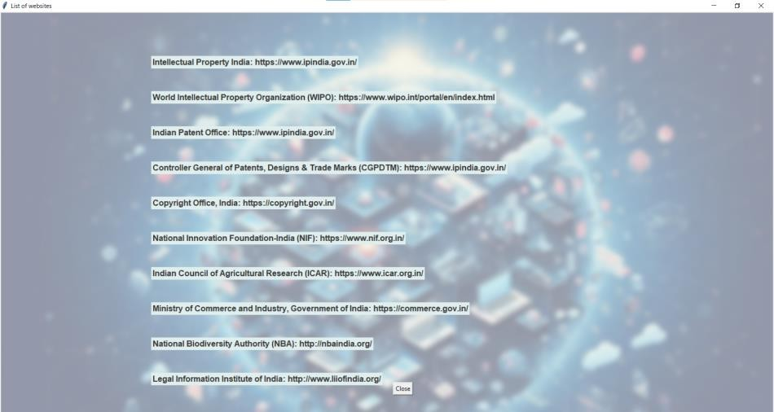
Fig: Laws Window
Fig: Websites Window

Slide 17
Conclusion
Developing an interactive gaming software focused on Intellectual Property (IP) awareness for school students addresses a significant educational gap which was not been covered in the curriculum. By leveraging the engaging nature of games, this project not only makes learning about IP rights fun but also ensures that students understand the importance of protecting their creative works. This innovative approach promises to inspire ultimately contributing to a more informed and active society

Slide 18
Future Scope
Expansion of Content:
Add more advanced IPR topics and related subjects.
Multilingual Support:
Introduce support for multiple languages to reach a broader audience.
Online Platform Integration:
Integrate with online learning platforms and LMS for broader educational use.

Slide 19
References
[1] Kanivets, Oleksandr, Gorda, Tetyana. Development of mobile applications of augmented reality for projects with projection drawings; February 9, 2020;[Google Scholar]
[2] Derbissalova, G., Shayakhmetova, A., Avagimyan, A. et al. Multimedia applications in special education: new opportunities for the developing of cognitive processes of children with intellectual disabilities. Multimed Tools Appl 83, 49707–49721 (2024). [Google Scholar]
[3] Wirawan, G., Abdulkarim, A., Komalasari, K. & Wiyanarti, E. (2023). Development of Mobile Games-Based Social Studies Instructional Media to Develop 21st Century Skills. Journal of Education, Teaching and Learning, 8(2), 226-235. STKIP Singkawang. Retrieved July 2, 2024 from [Google Scholar]
[4] Aboites, J., & Cimoli, M. (2002). Intellectual property rights and national innovation systems- Some lessons from the Mexican experience. Revue D’économie Industrielle, 99(1), 215–232.

Slide 20
[5] Adams, S., (2011). Intellectual property rights, innovation and economic growth in Sub- Saharan, Africa.Journal of Third World Studies, 28(1), 231-243.
[6] Archibong, E. E., Ibia, K.-U. T., Muniandi, B., Dari, S. S., Dhabliya, D., & Dadheech, P. (2024). The Intersection of AI Technology and Intellectual Property Adjudication in Supply Chain Management. In AI and Machine Learning Impacts in Intelligent Supply Chain (pp. 18).
[7] Zhang, Y., Li, X., & Wang, H. (2024). AI-Driven Innovations in Supply Chain Risk Management: Protecting Intellectual Property. In AI and Machine Learning Impacts in Intelligent Supply Chain (pp. 25-39).
[8] Liu, F., & Chang, Y. (2024). Challenges and Opportunities in AI-Powered Supply Chains: An Intellectual Property Perspective. In AI and Machine Learning Impacts in Intelligent Supply Chain (pp. 73-88).
[9] "International Intellectual Property in an Integrated World Economy":
Abbott, F. M., Cottier, T., Gurry, F., Abbott, R. B., Burri, M., & Grosse Ruse-Khan, H. (2024). International Intellectual Property in an Integrated World Economy (4th ed.). Aspen Publishers.
[10] Klawitter, R., & Shire, C. (2024). Licensing Intellectual Property: Law and Application (3rd ed.). Wolters Kluwer.

Slide 21
Question and Answers
Do ask any questions regarding the whole proposal

Slide 22
Thank You

